Slide 1
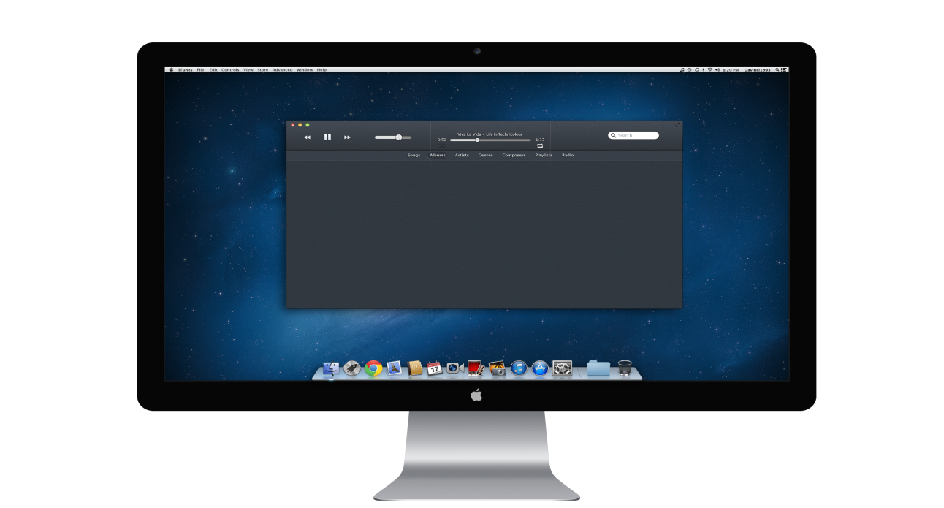

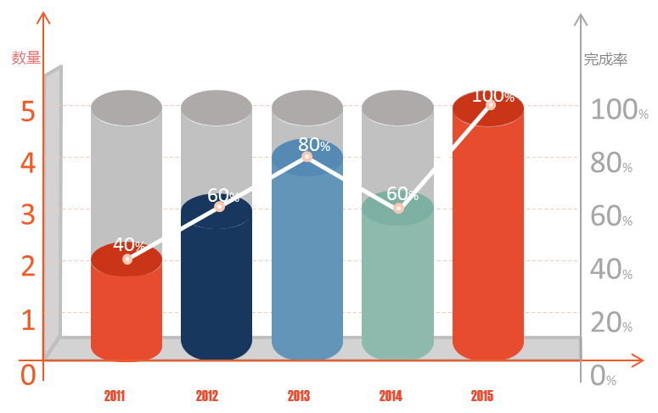
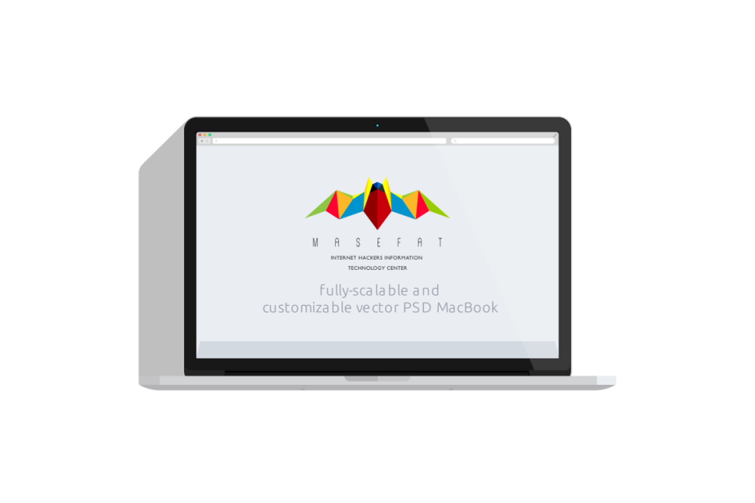


Customer segmentation Analysis
Research based on customers’ purchasing data
Reporter: Mark Date: 08/02/2021

Slide 2
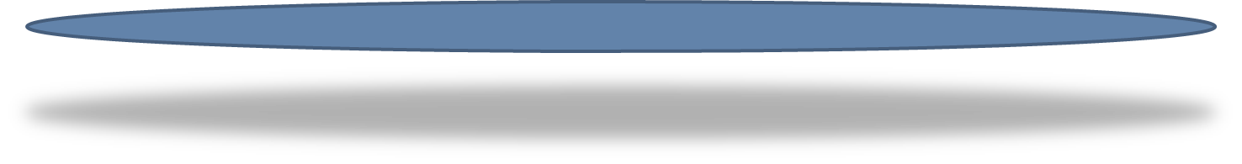
Contents
01
Business Purpose
OPTION
02
Data Exploration
OPTION
03
Data Modeling
OPTION
04
Analysis and Recommendation
OPTION

Slide 3

01
Business Purpose
1.How many products people usually order? 2. Which products are ordered the most? 3. Which product is most likely to be added first in cart? 4. What is the time at which people usually order products?
5. What are customers' favourite departments and Aisles?
6. What is the best selling Aisles in each department based on number of orders?

Slide 4
02
Data Exploration

Slide 5
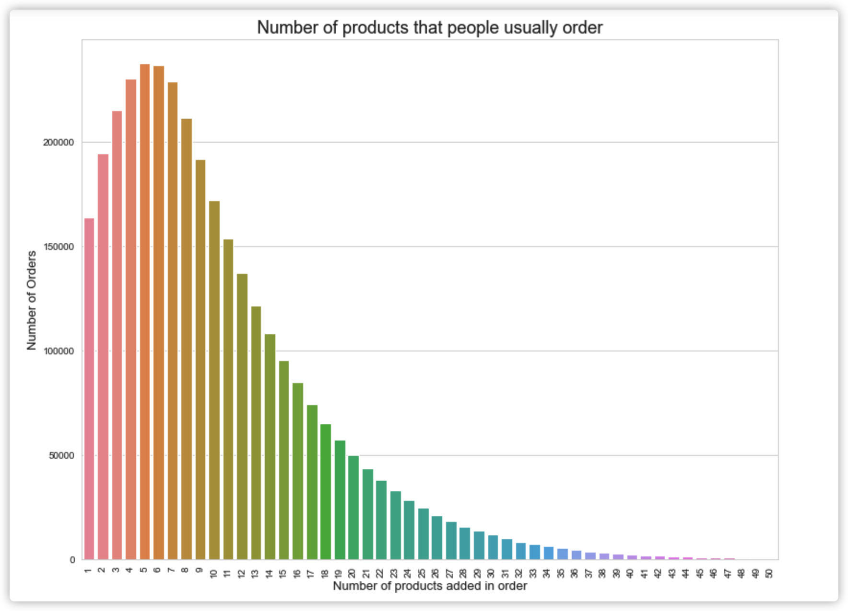
How many products people usually order?
In the plot, we can find out that people usually order 4 to 7 products each order.
The number of orders of 5 products is
237225

Slide 6
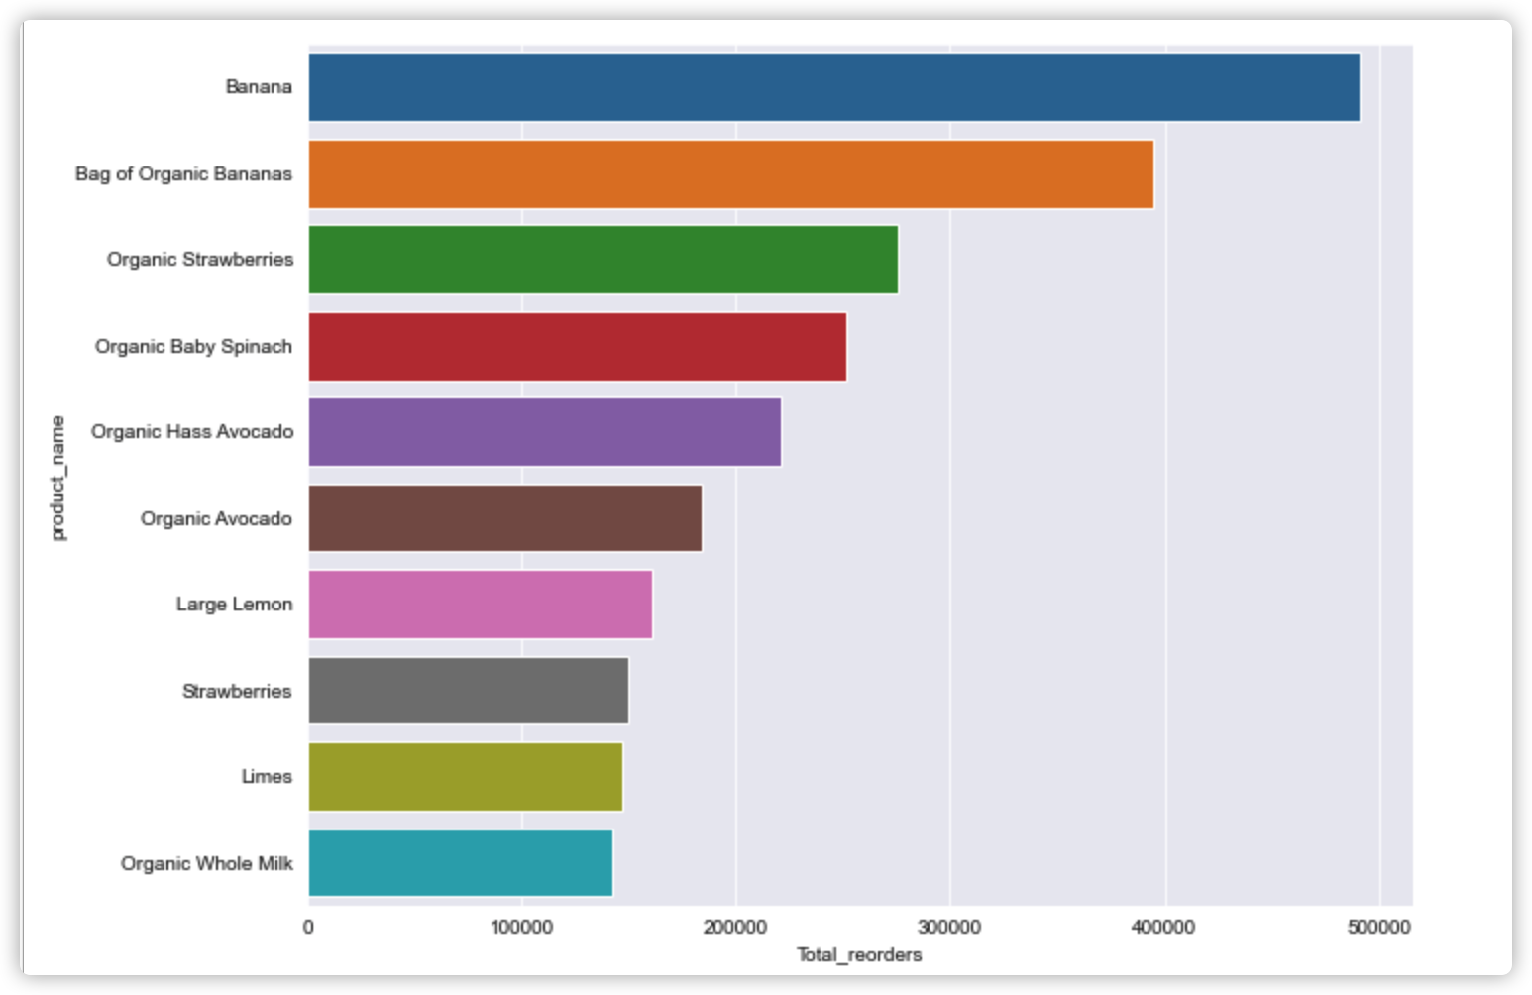
Which products are ordered the most?
In the plot, we can find out that the most popular products is banana.

Slide 7
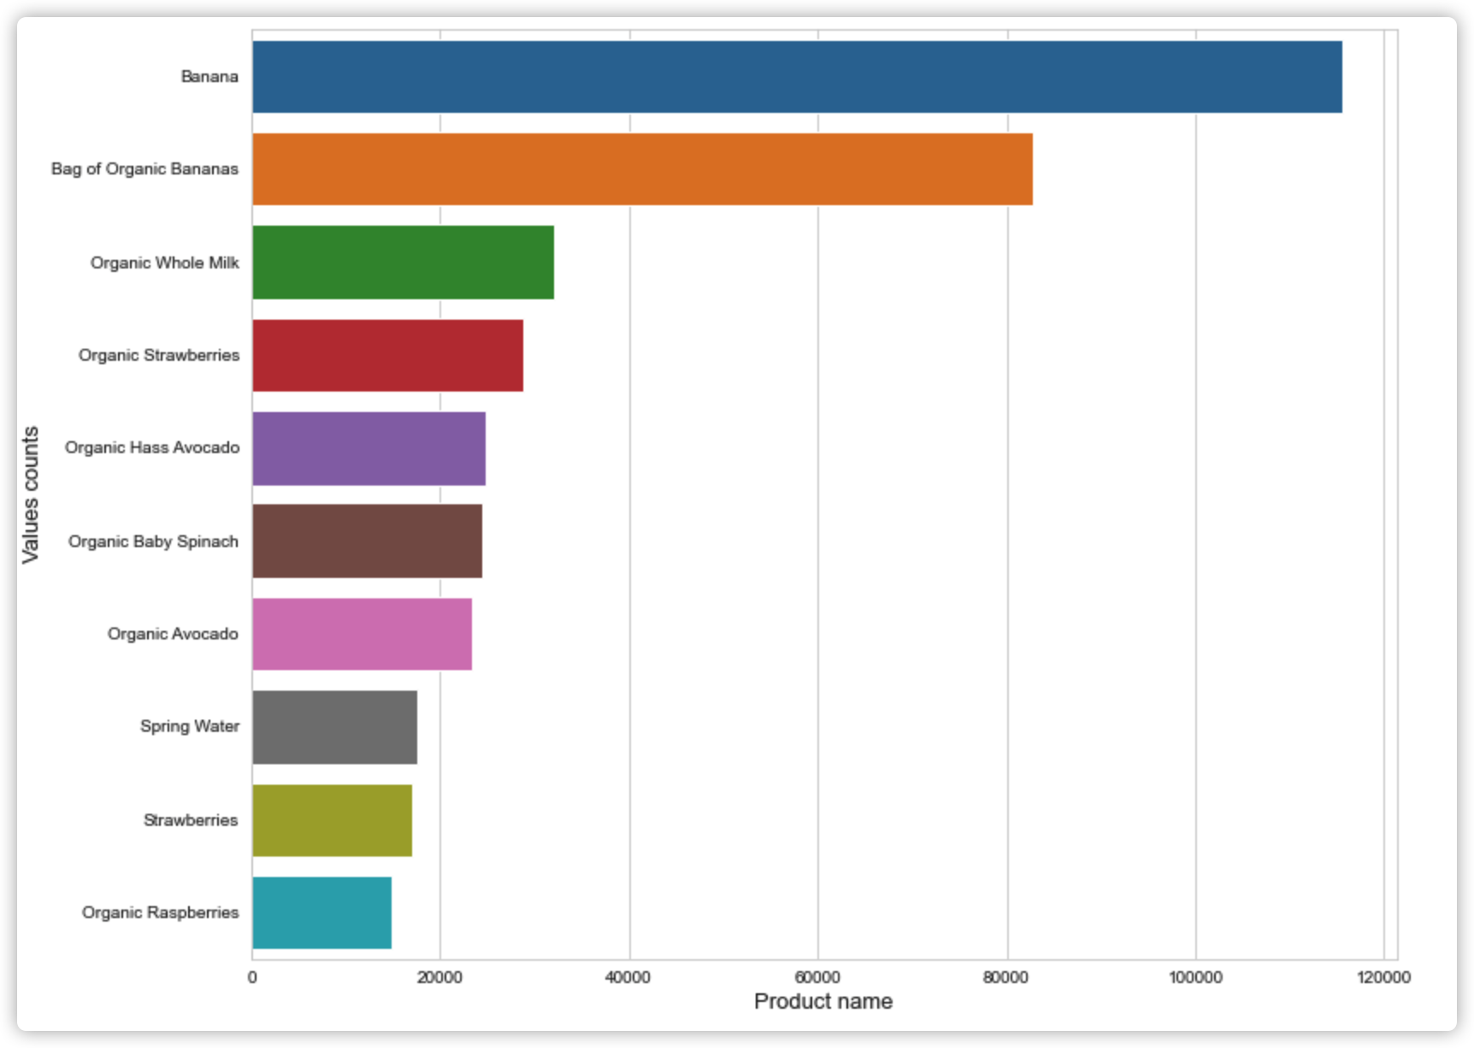
Which product is most likely to be added first in cart?
In the plot, we can find out that people are more willing to add banana to cart first.

Slide 8
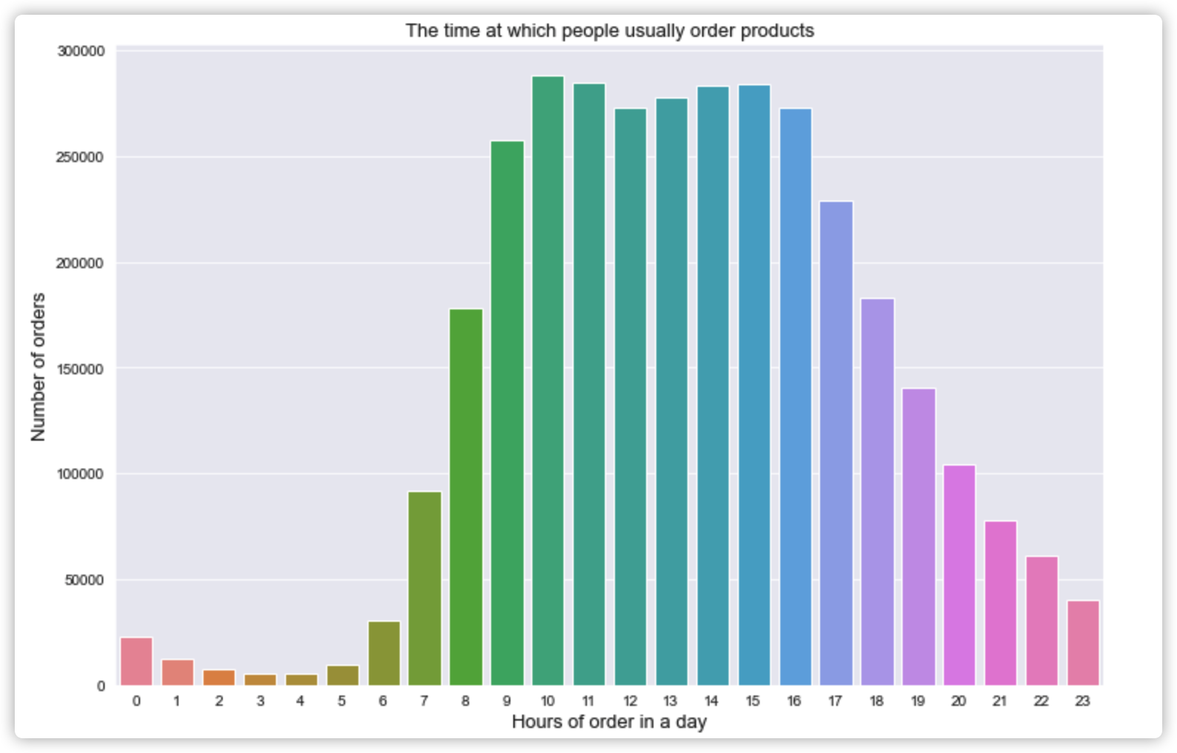
What is the time at which people usually order products?
In the plot, we can find out that majority of the orders are made during day time like 9 o’clock to 17 o’clock.

Slide 9
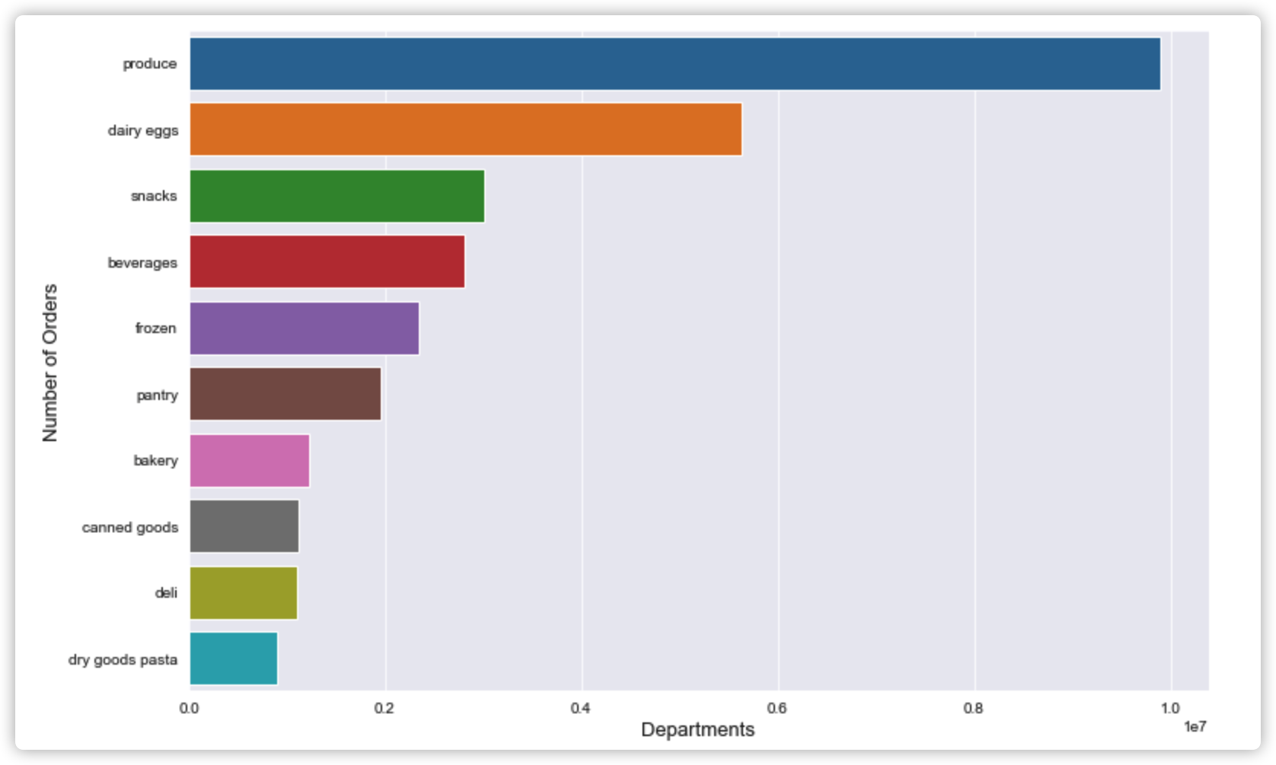
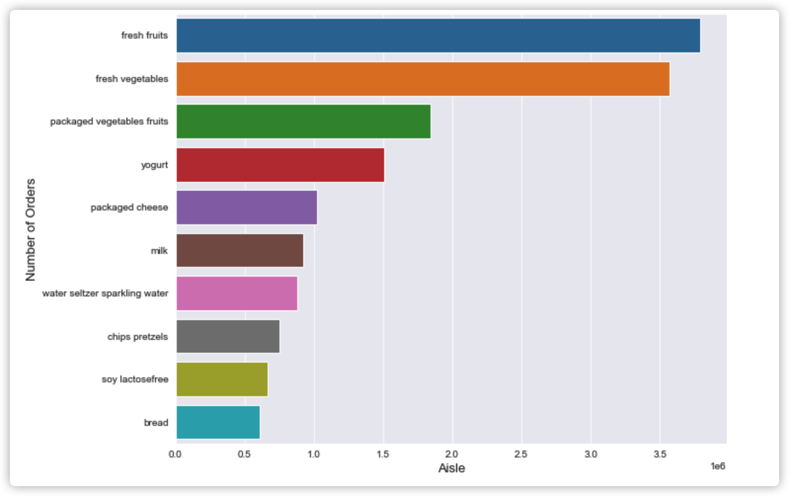
What are customers' favorite departments and Aisles?
In the plot, we can find that the most popular department is produce and the most popular aisle is fresh fruits.

Slide 10
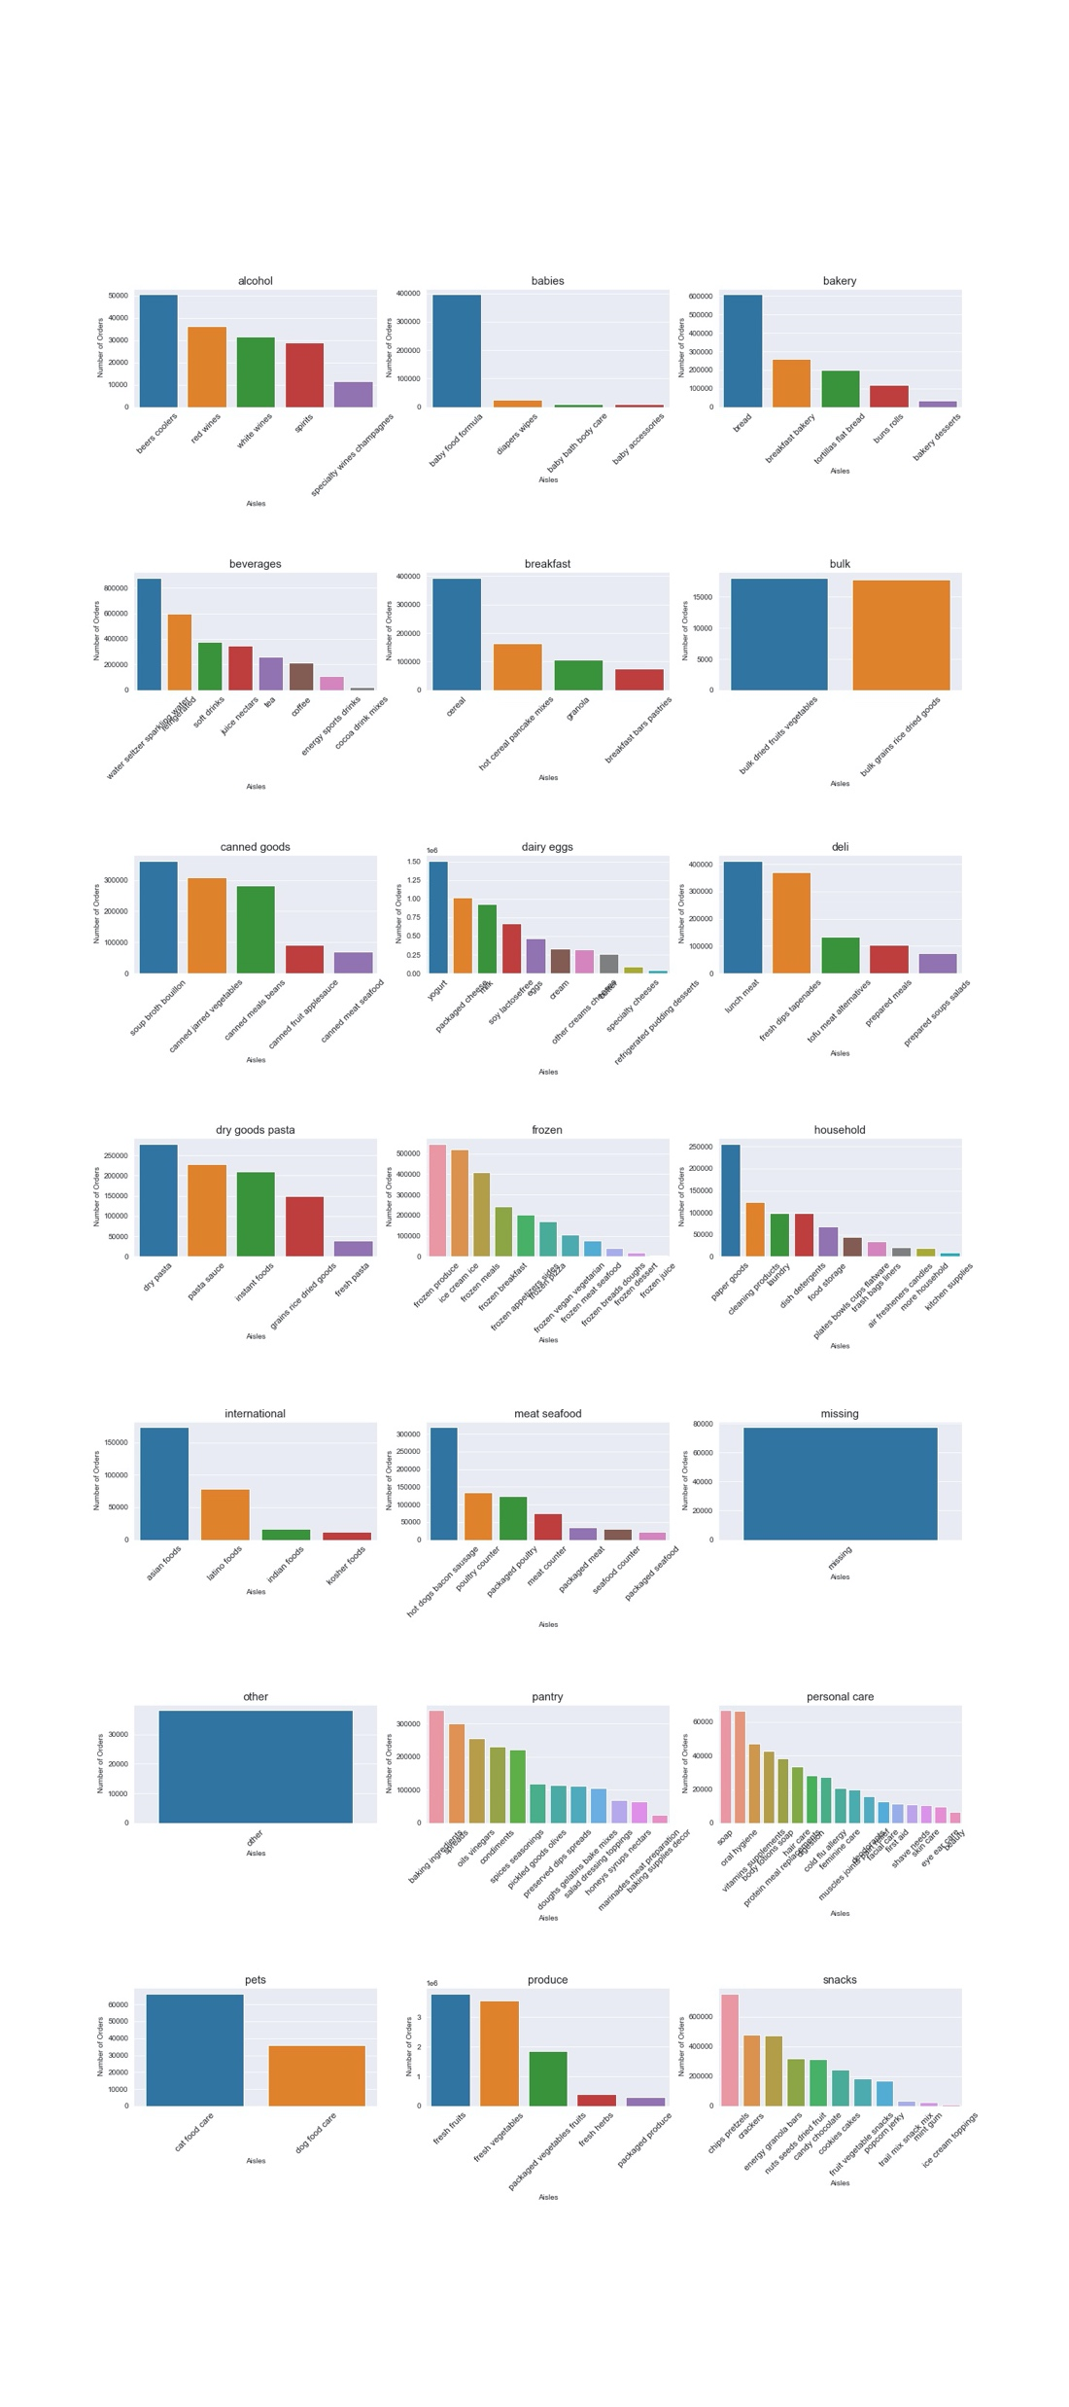
What is the best selling Aisles in each department based on number of orders?
In the plot, we can find that the most popular aisle in each department based on number of orders.

Slide 11
03
Data Modeling

Slide 12
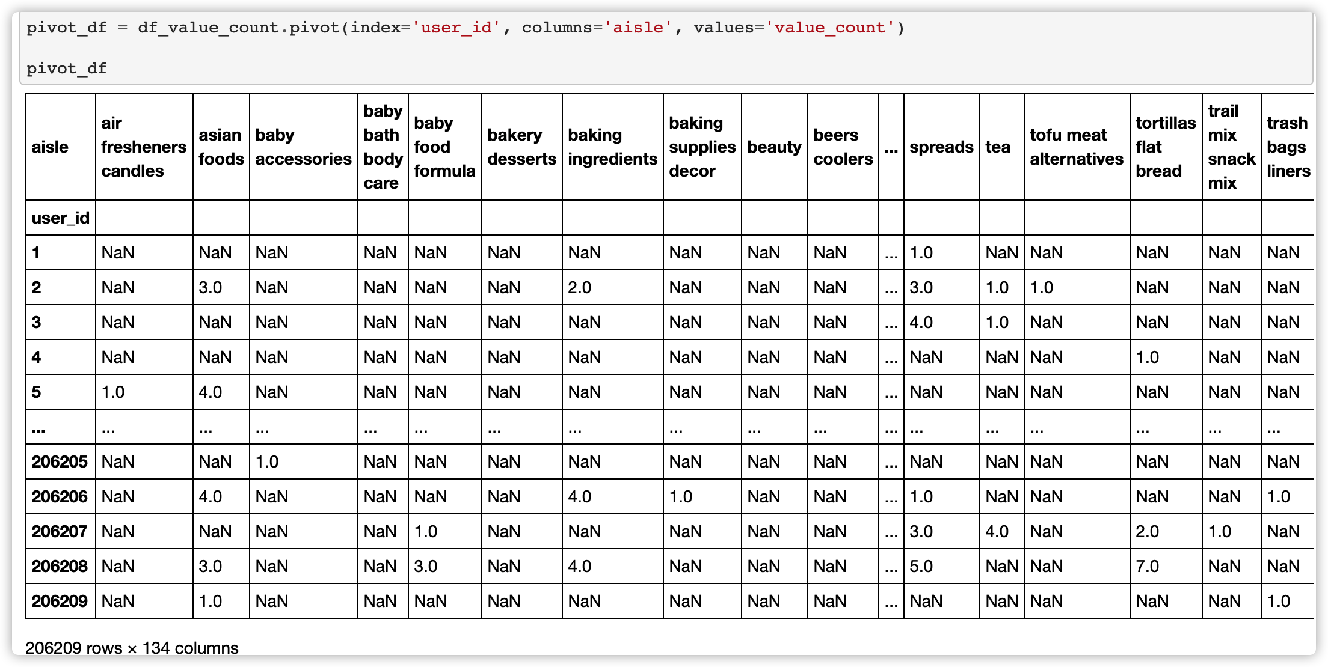
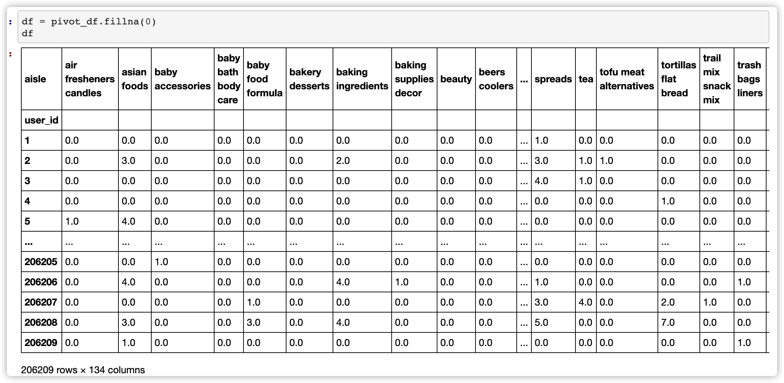
Data preparation
Data source:
orders_csv,order_products.csv, products.csv,aisle.csv,deparment.csv
Approach:
Join five table together.
点击输入简要文字内容……
Missing Data:
Replace NA with 0

Slide 13
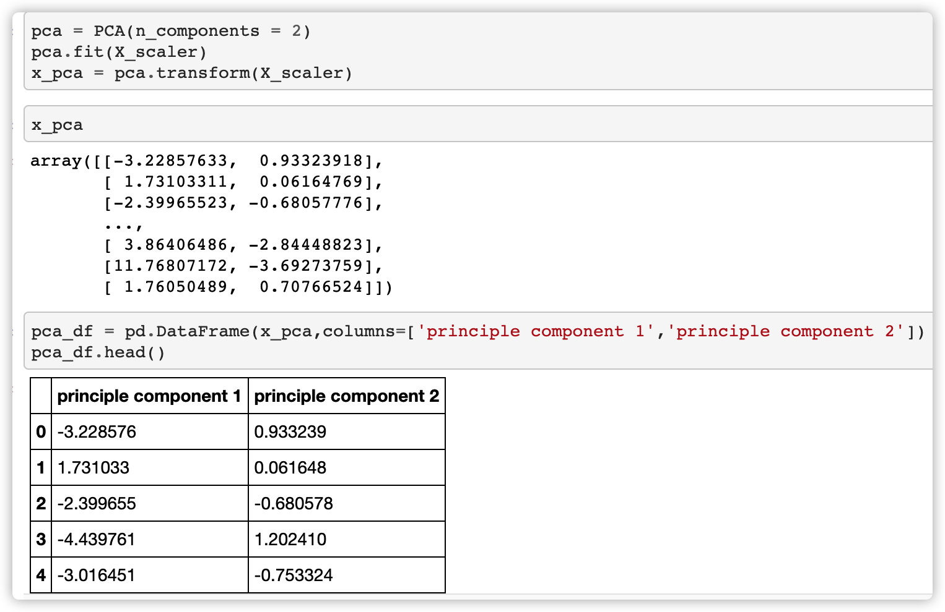
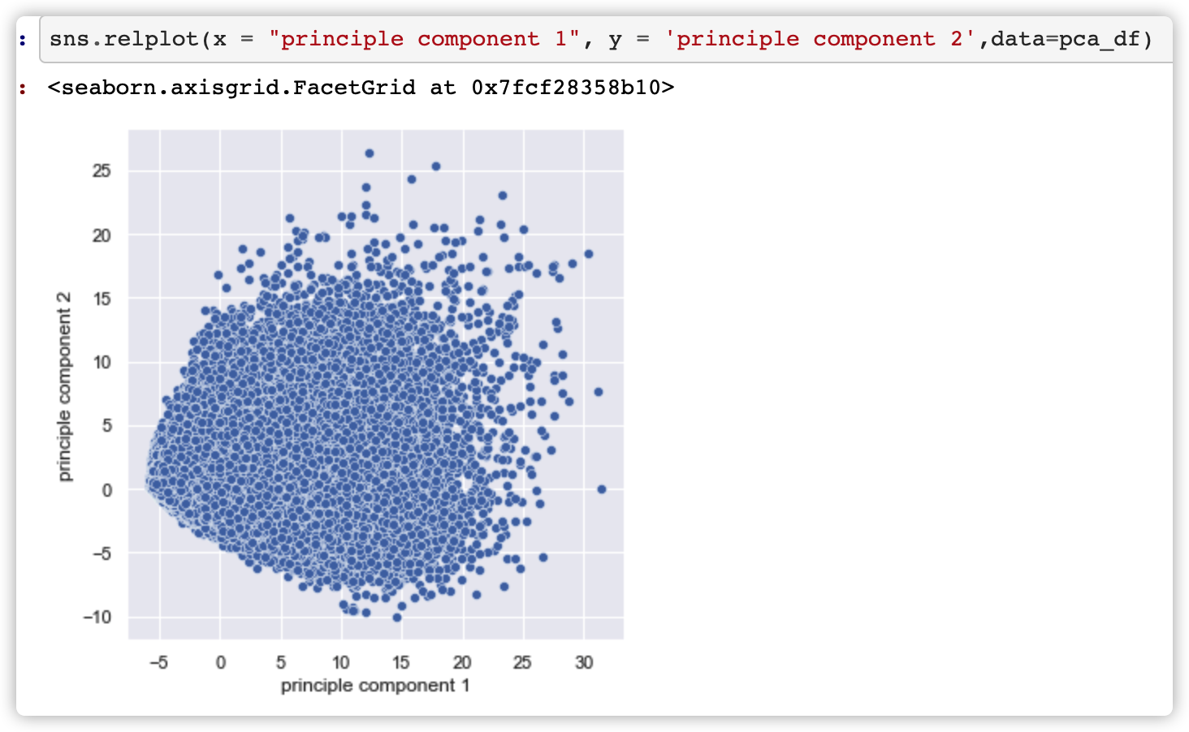
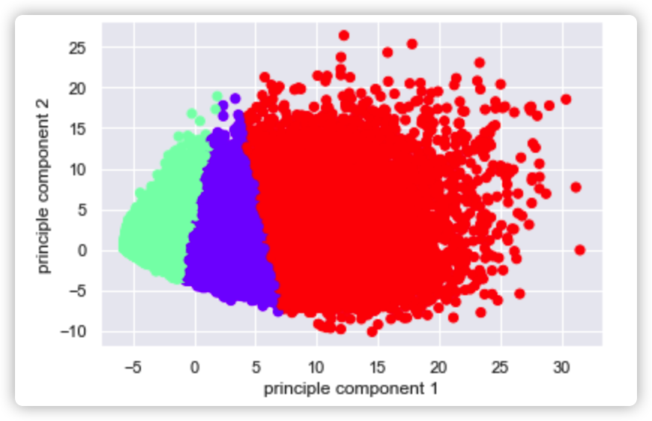
Data Transformation(Log) and PCA

Slide 14
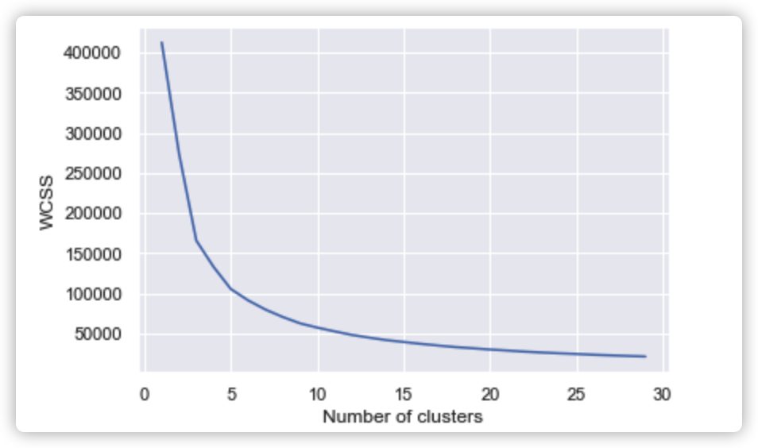
Data Modeling
From the Elbow method plot,
we can find that 5 cluster may
have a better performance.

Slide 15
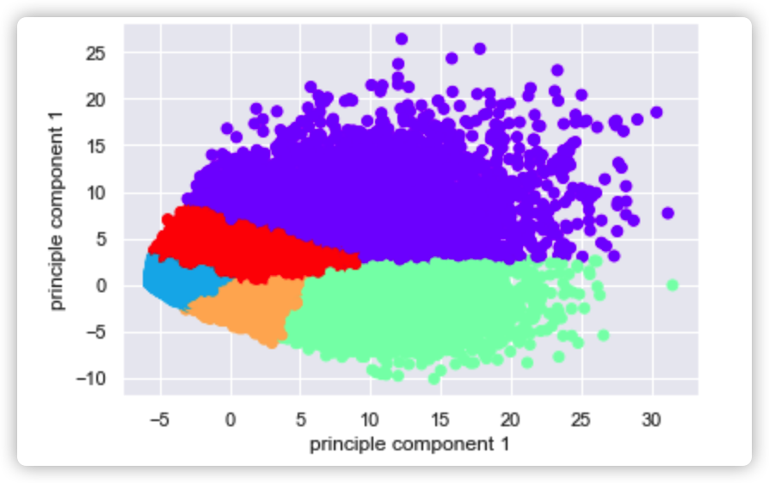
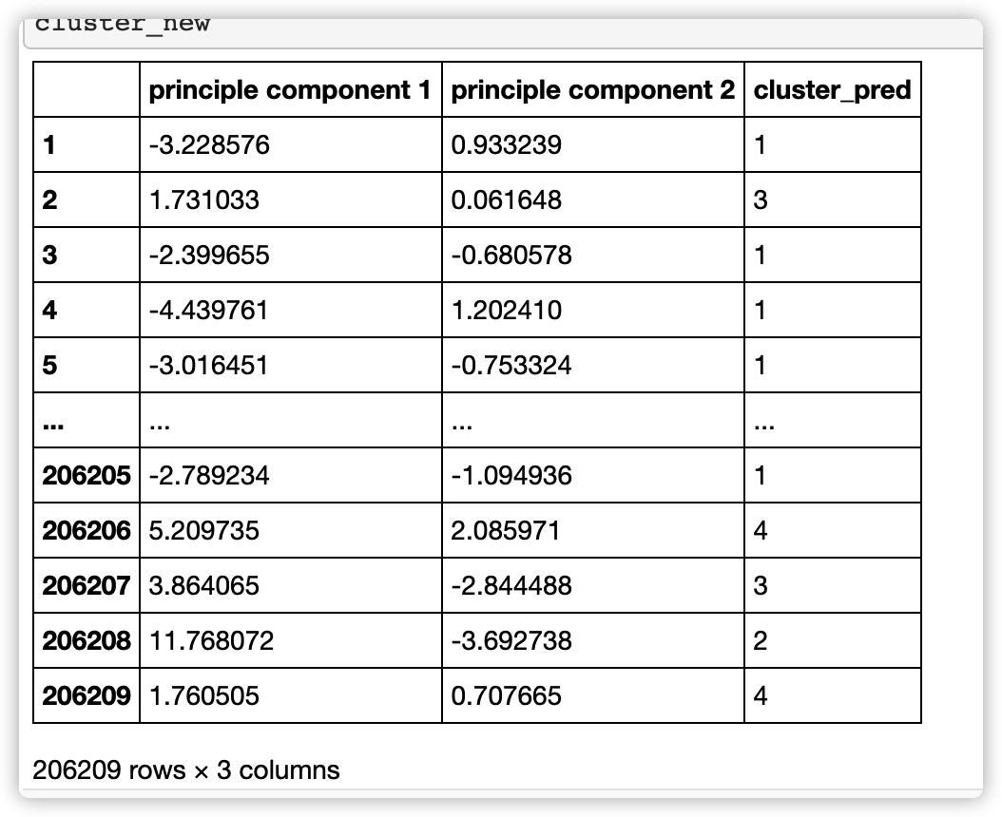
Segment data into several clusters
Here is the new cluster plot and table.

Slide 16
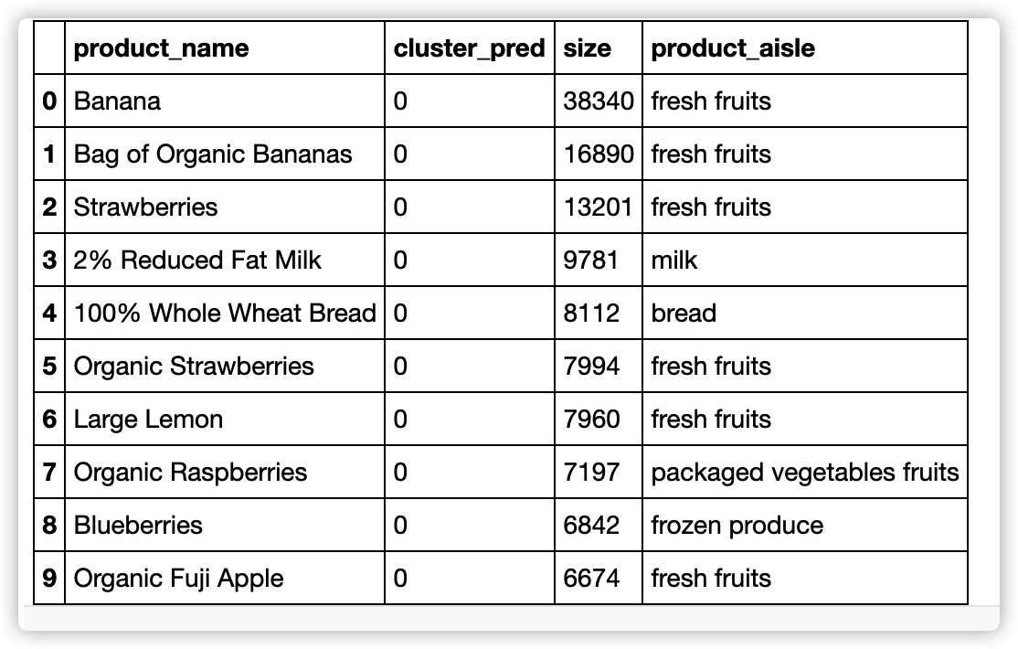
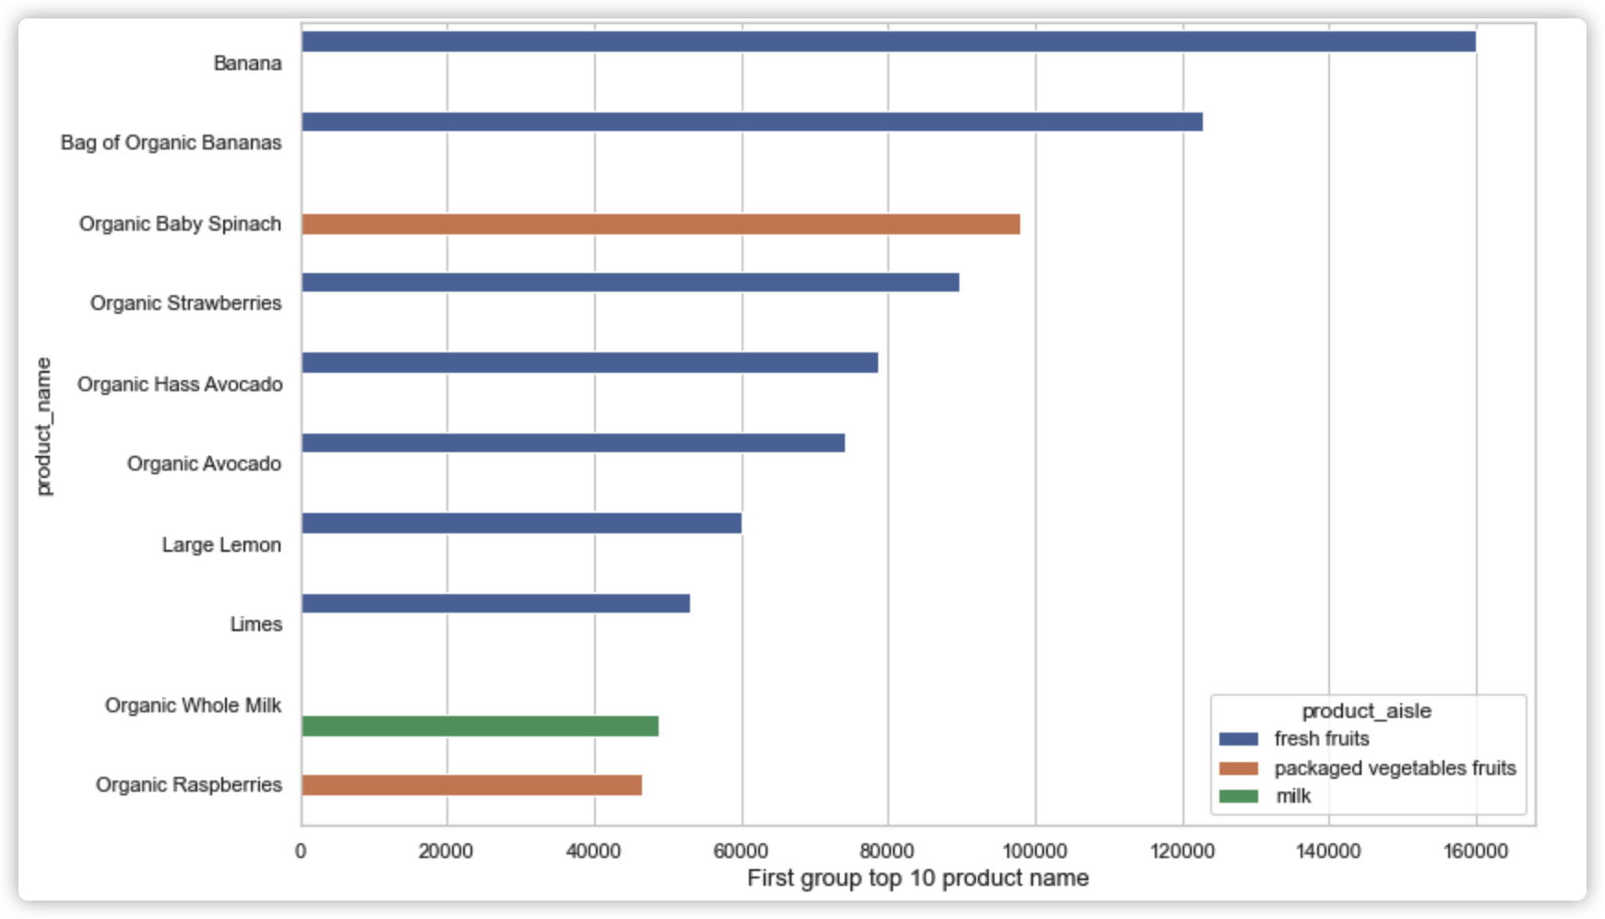
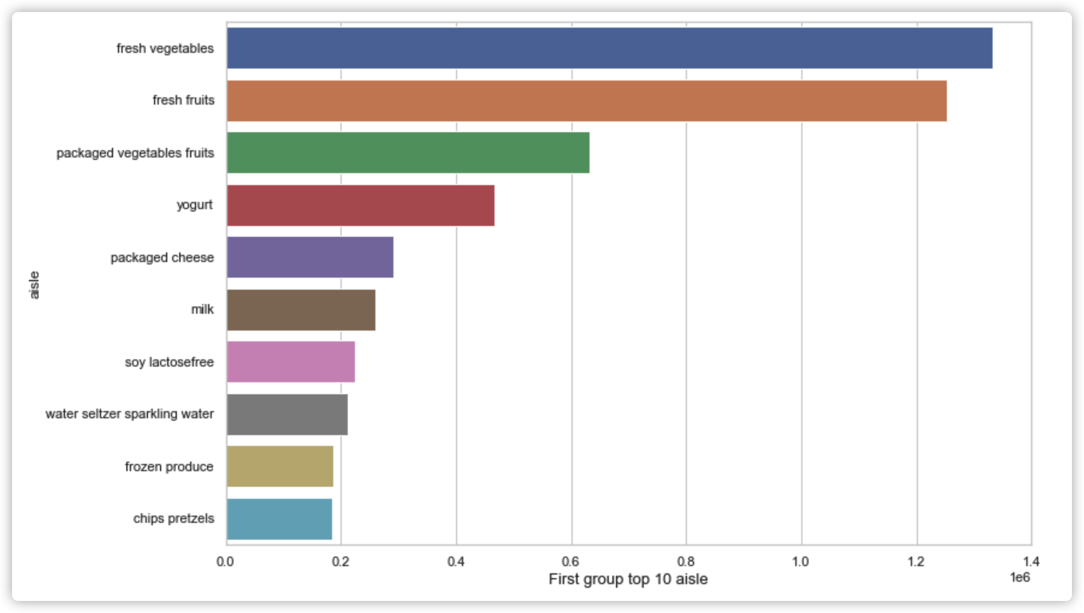
Details of each cluster
Here is the group 0 plot and table.

Slide 17
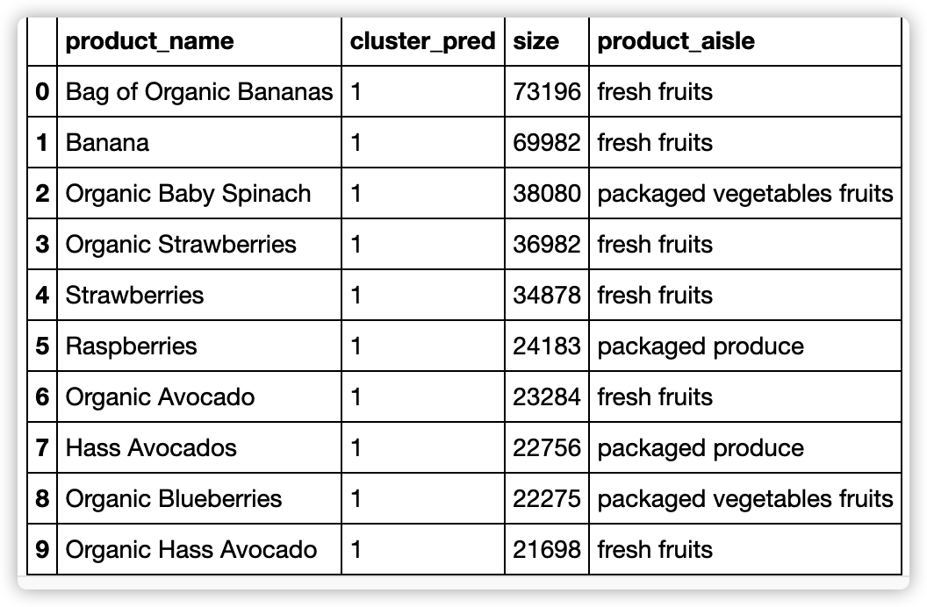
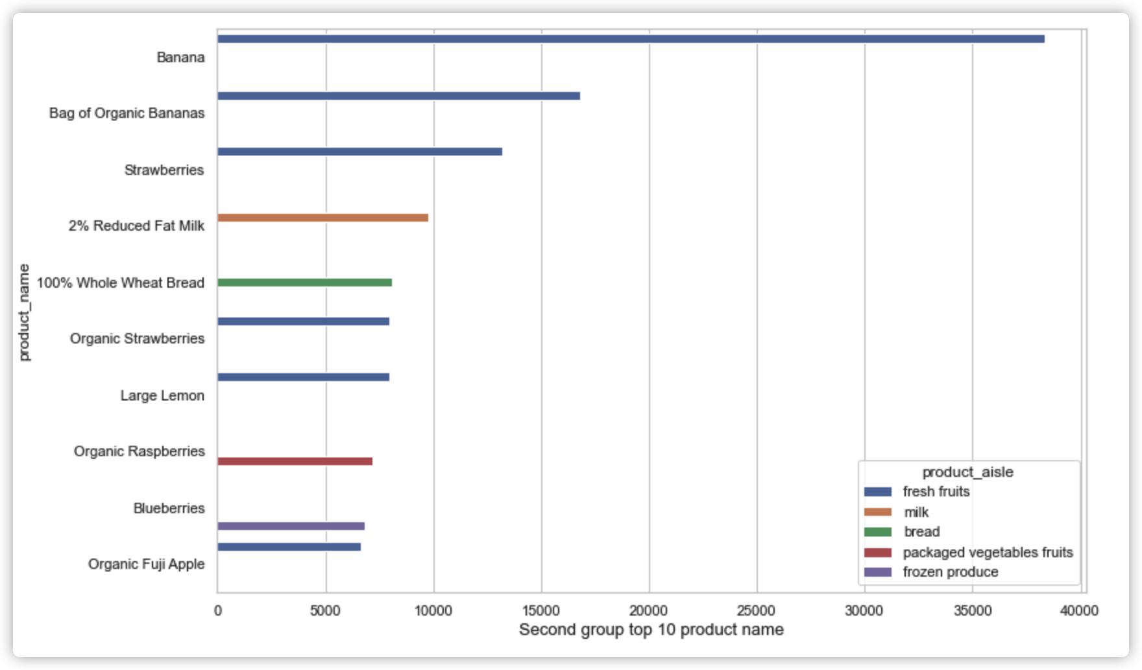
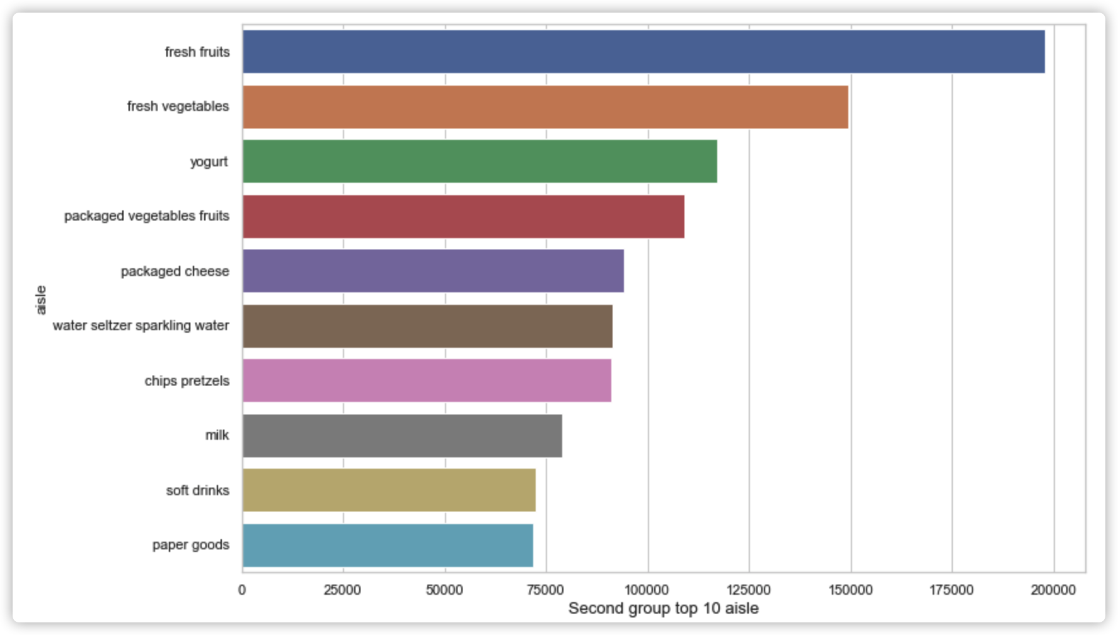
Details of each cluster
Here is the group 1 plot and table.

Slide 18
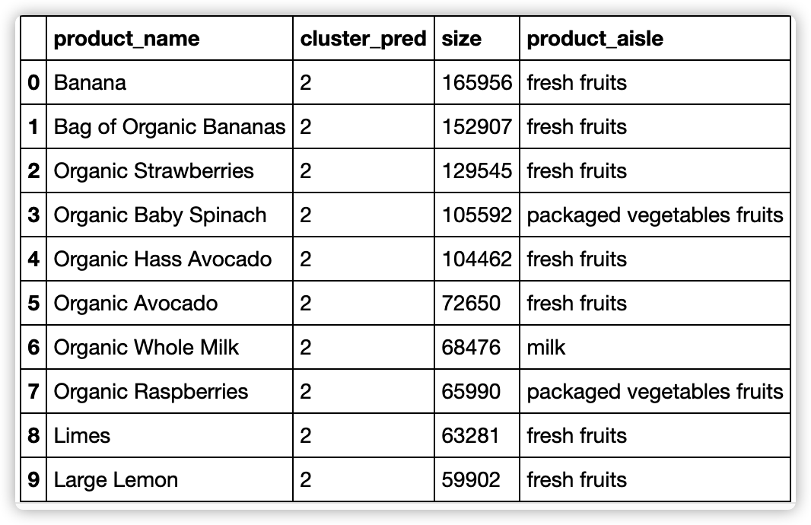
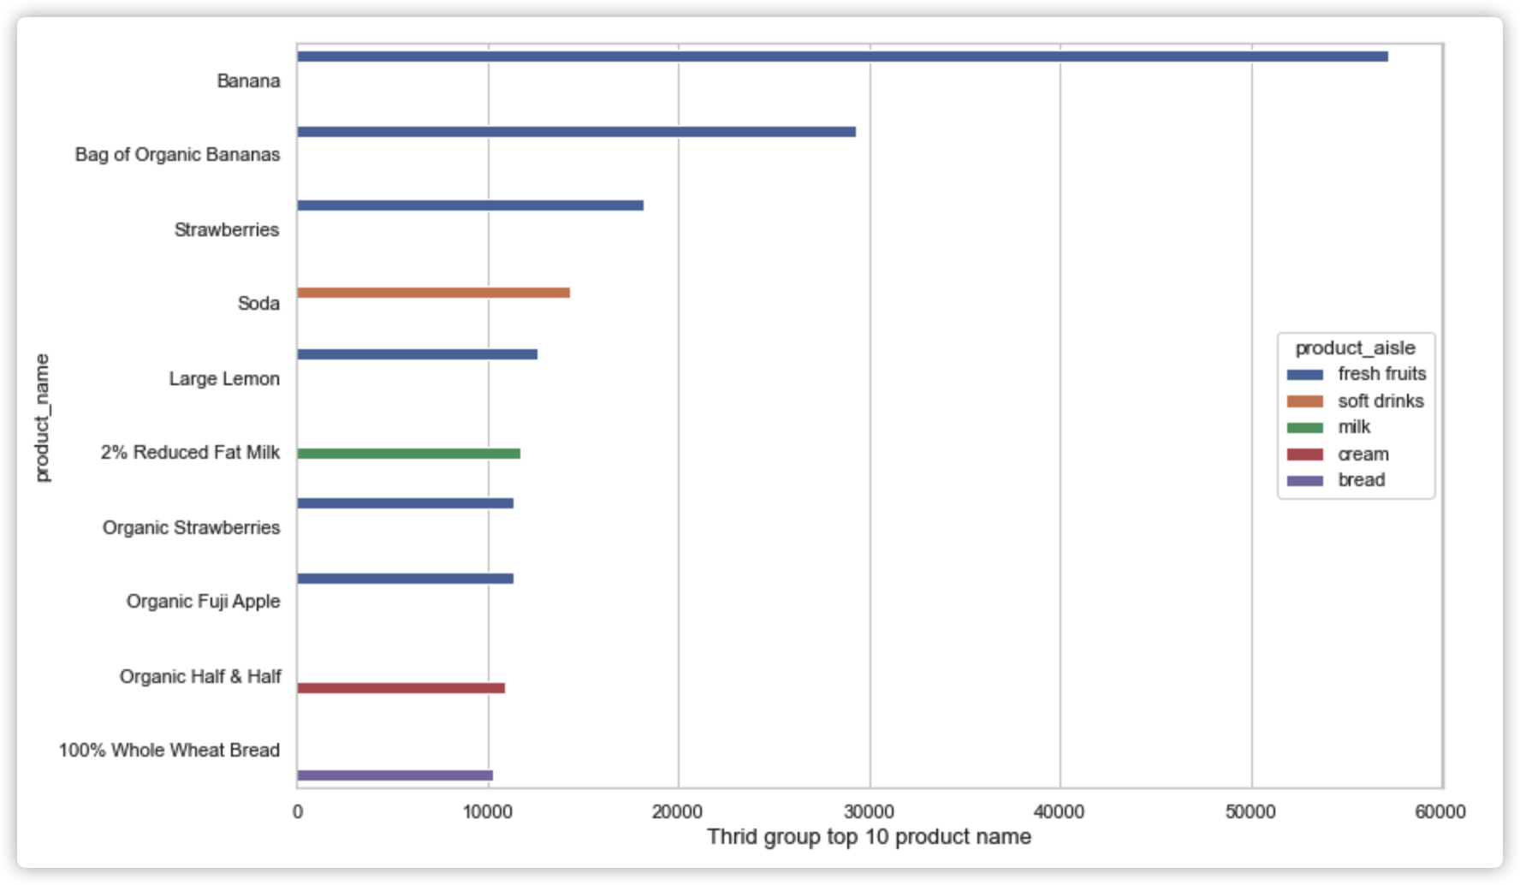
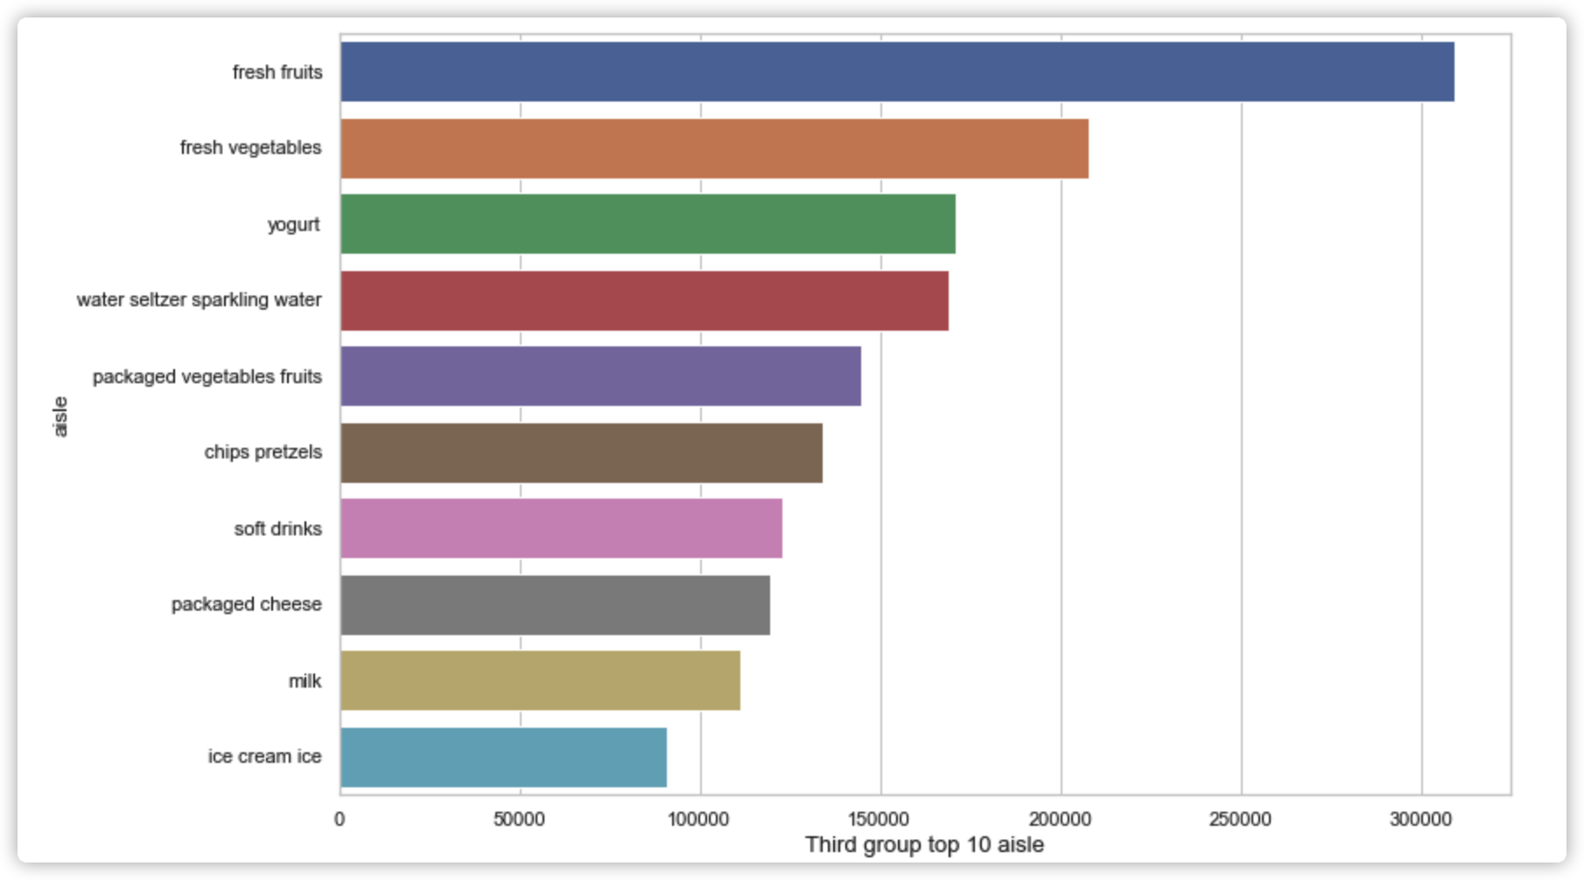
Details of each cluster
Here is the group 2 plot and table.

Slide 19
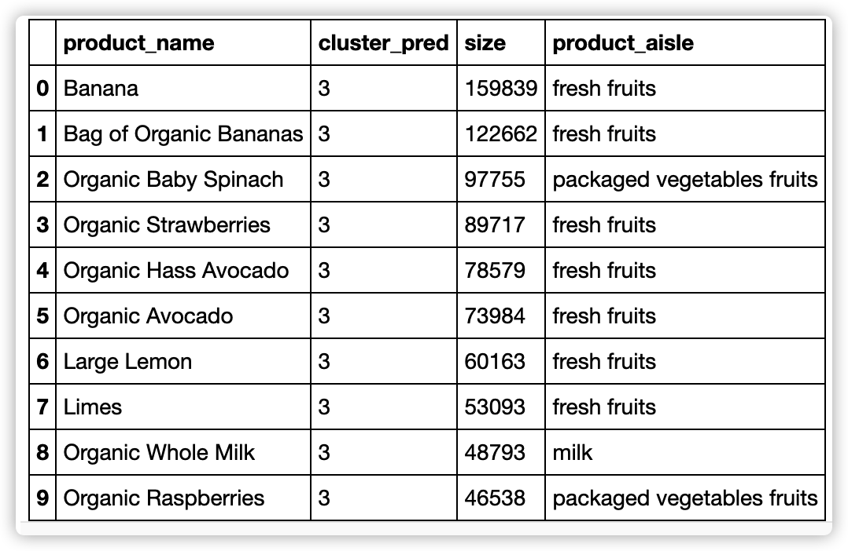
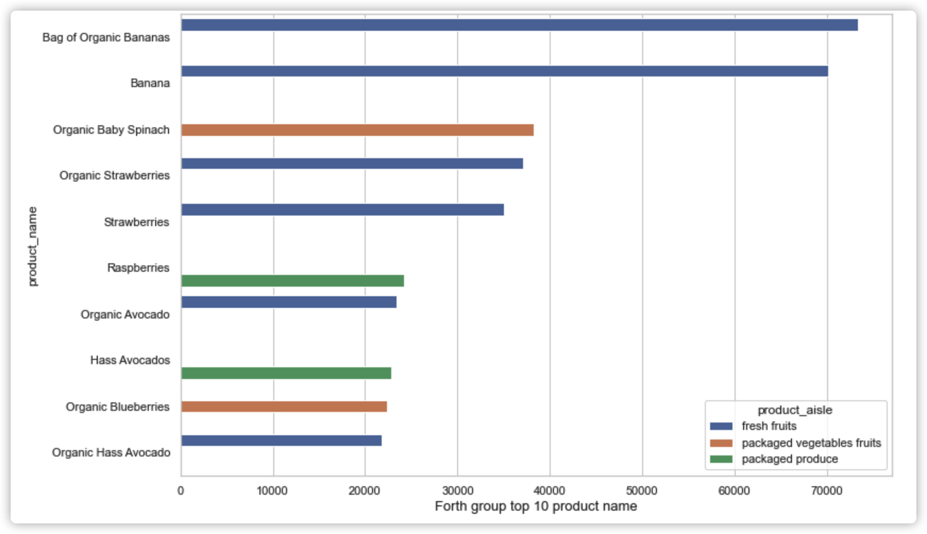
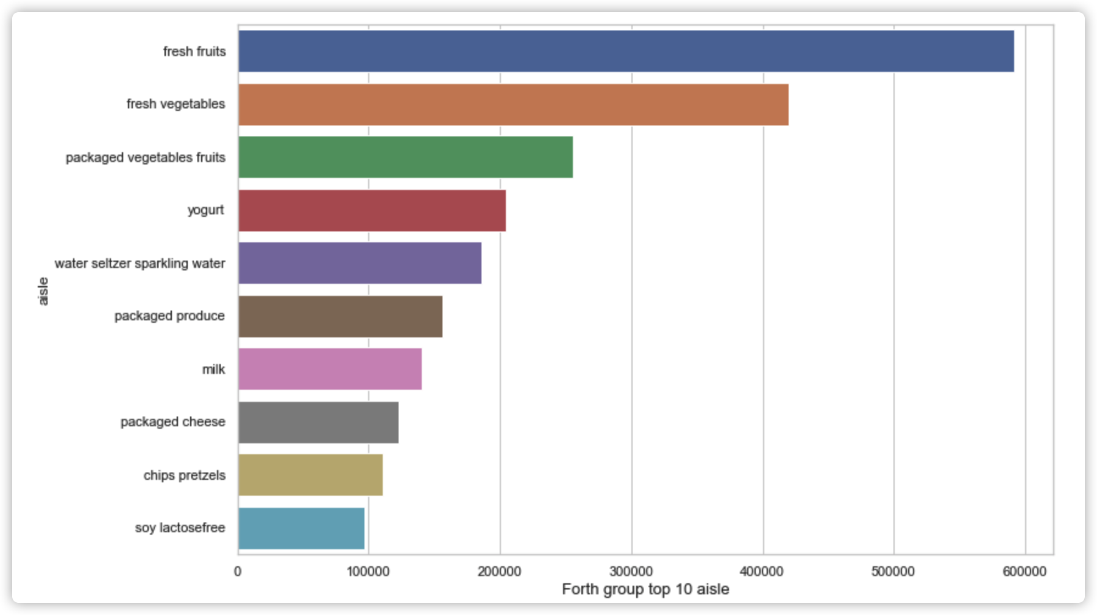
Details of each cluster
Here is the group 3 plot and table.

Slide 20
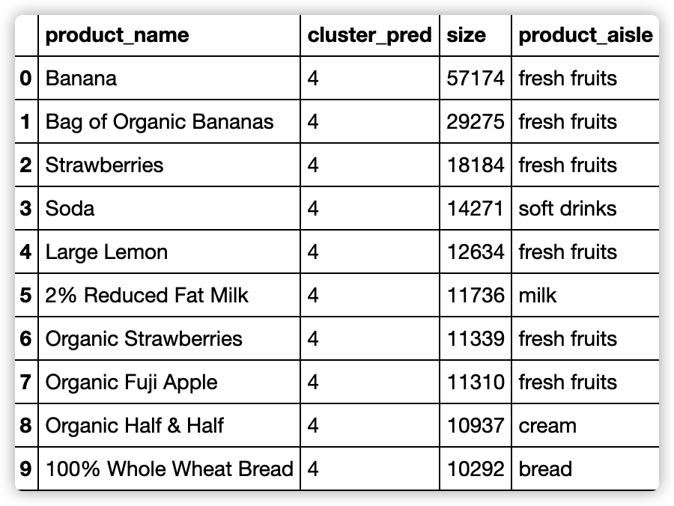
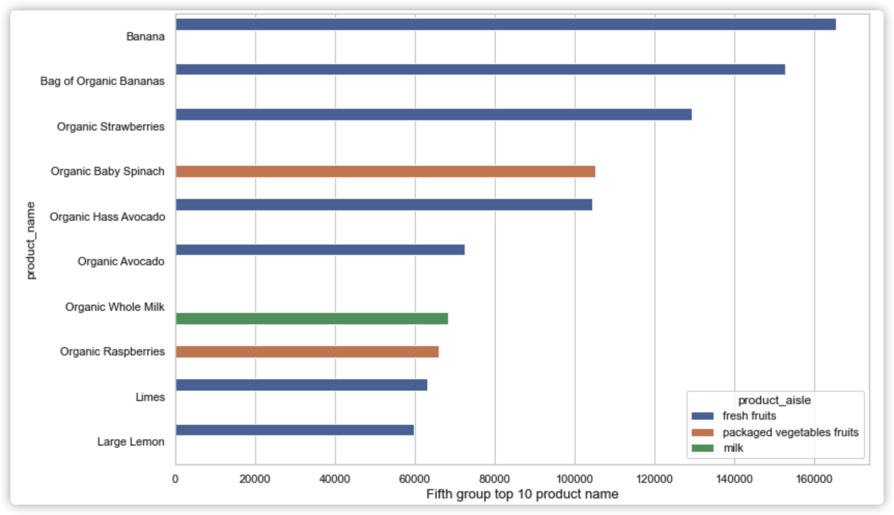
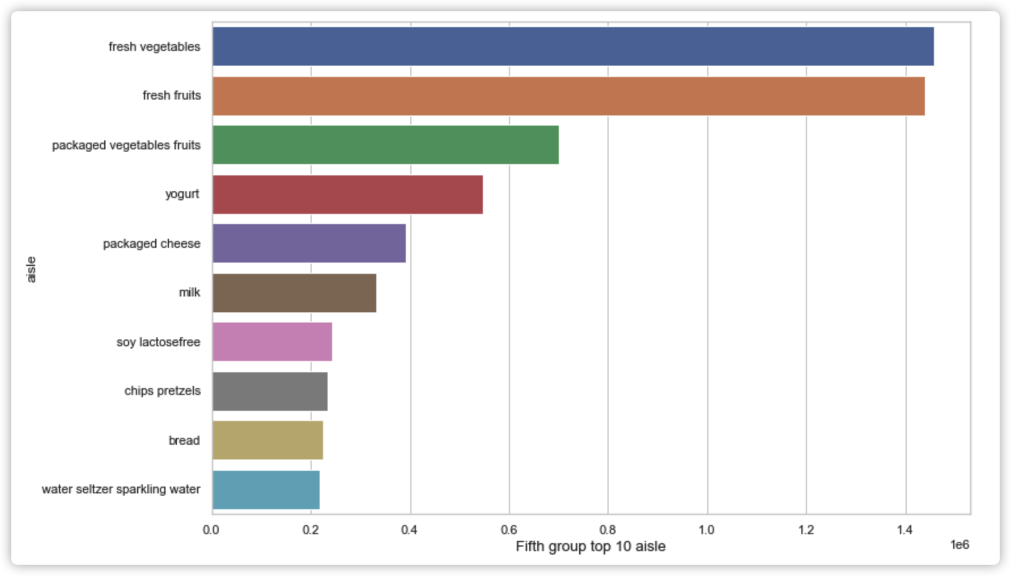
Details of each cluster
Here is the group 4 plot and table.

Slide 21
04
Analysis and Recommendation

Slide 22
Analysis and Recommendation
Through the given figure following things can be interpreted:
1.Most of users order fresh fruits in this market and as we can see in the plot fresh fruit and vagetables are the top 2 favorite aisles that users prefer to order.
2.The users in the first and last group ordered more yogurt than packaged vegetables fruit.
3. Banana and bage of organic bananas are the most favorite food in all cluster which are always the top 2 products that user usually order.
4. The user in the first group prefer to order some packaged vegetable fruits like organic babay spinach and less likely to order milk.
5. The user in the second group also prefer to order some packaged vegetable fruits like organic babay spinach and less likely to order packaged produce.
6. The user in the third group have the same preference on bread, packaged vegatable fruits and frozen produce.
7. The user in the forth group have the same preference on soft drink, milk, cream and bread.
8. The user in the last group also prefer to order some packaged vegetable fruits like organic babay spinach and more likely to order milk than the first group.
The ultimate goal of any market would be to increase the sales volumns. According to the analysis, market can recommand target products to users or bundle sales of the favorite products and less favorite products.

Slide 23
Thank you for watching!

